Slide 1
Angular Framework
Building Modern Web Applications
A structured approach to frontend development

Slide 2
What is Angular?
Angular is a TypeScript-based frontend framework
Developed and maintained by Google
Used to build dynamic single-page applications
Focuses on scalability and maintainability

Slide 3
Why Use Angular?
Structured and opinionated architecture
Strong tooling and CLI support
Two-way data binding
Built-in testing support
Large community adoption

Slide 4
Angular Architecture Overview
Modules organize the application
Components define UI and logic
Services handle business logic
Dependency Injection connects everything

Slide 5
What is TypeScript?
Superset of JavaScript
Adds static typing
Improves readability and safety
Required for Angular development

Slide 6
Angular Modules
Root module: AppModule
Feature modules for scalability
Lazy loading support
Improves application structure

Slide 7
Angular Components
Core building blocks of Angular
Control a section of the UI
Consist of template, class, and styles

Slide 8
Component Lifecycle
ngOnInit
ngOnChanges
ngAfterViewInit
ngOnDestroy
Manages component behavior

Slide 9
Angular Templates
Written in HTML
Supports data binding
Uses Angular directives
Declarative UI approach

Slide 10
Data Binding in Angular
One-way binding
Two-way binding
Interpolation
Property and event binding

Slide 11
Interpolation
Displays dynamic data
Syntax uses double curly braces
Evaluates TypeScript expressions

Slide 12
Two-Way Data Binding
Combines property and event binding
Uses ngModel
Requires FormsModule
Common in forms

Slide 13
Angular Directives
Add behavior to DOM elements
Structural and attribute directives
Improve dynamic rendering

Slide 14
Structural Directives
Change DOM structure
ngIf
ngFor
ngSwitch

Slide 15
Attribute Directives
Change appearance or behavior
ngClass
ngStyle

Slide 16
Angular Services
Contain reusable business logic
Shared across components
Promote clean architecture

Slide 17
Dependency Injection
Injects services into components
Improves modularity
Simplifies testing

Slide 18
Angular Routing
Enables navigation between views
Single-page application behavior
Uses RouterModule

Slide 19
Route Guards
Control route access
CanActivate
CanDeactivate

Slide 20
Angular Forms
Collect and validate user input
Template-driven forms
Reactive forms

Slide 21
Template-Driven Forms
Simple and easy to use
Logic written in HTML
Uses ngModel

Slide 22
Property and Event Binding
Property binding updates element properties
Event binding responds to user actions
Connects UI with logic

Slide 23
Reactive Forms
Logic written in TypeScript
Highly scalable and testable
Uses FormGroup and FormControl

Slide 24
HTTP Client in Angular
Communicates with backend services
Supports REST APIs
Uses HttpClient module

Slide 25
Observables and RxJS
Handle asynchronous data
Stream-based programming
Powerful data operators

Slide 26
Angular CLI
Creates and manages projects
Generates components and services
Builds and serves applications

Slide 27
Testing in Angular
Unit testing support
End-to-end testing tools
Encourages test-driven development

Slide 28
Advantages of Angular
Strong structure
High performance
Scalable framework
Enterprise-ready

Slide 29
Conclusion
Powerful frontend framework
Ideal for large applications
Clean architecture
Strong ecosystem

Slide 30
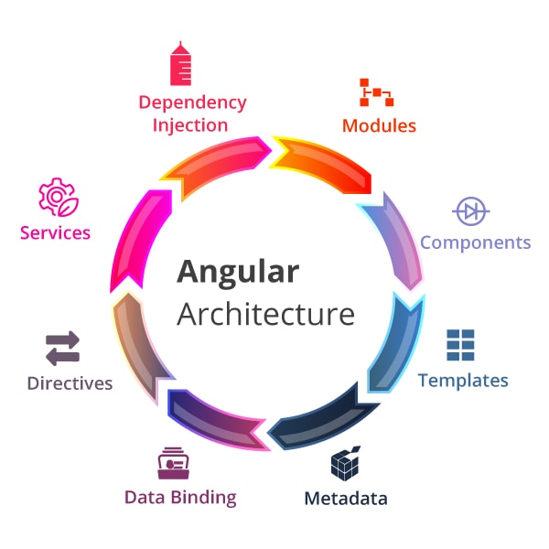
Summary

