Slide 1
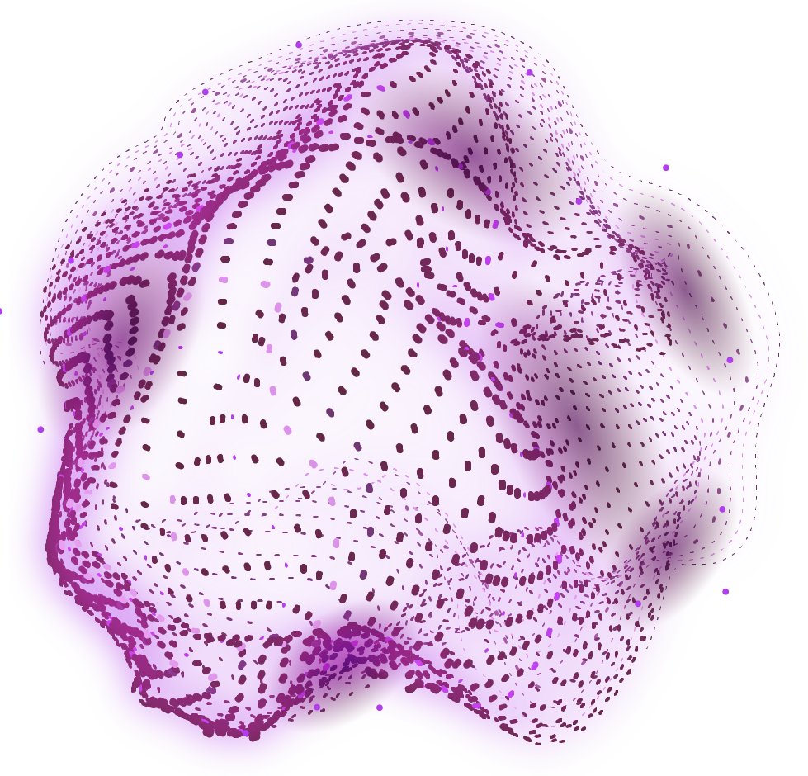
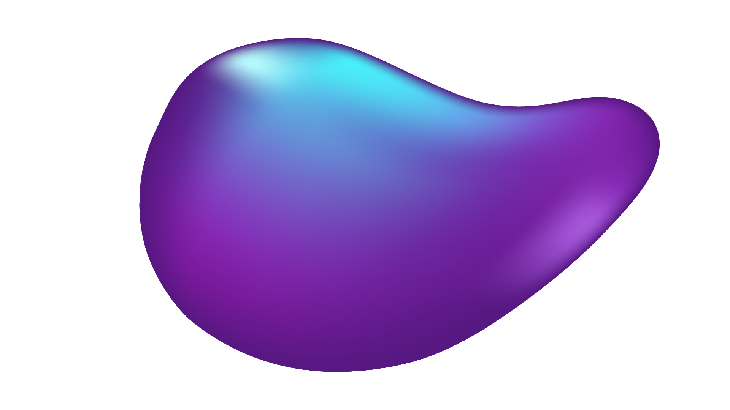
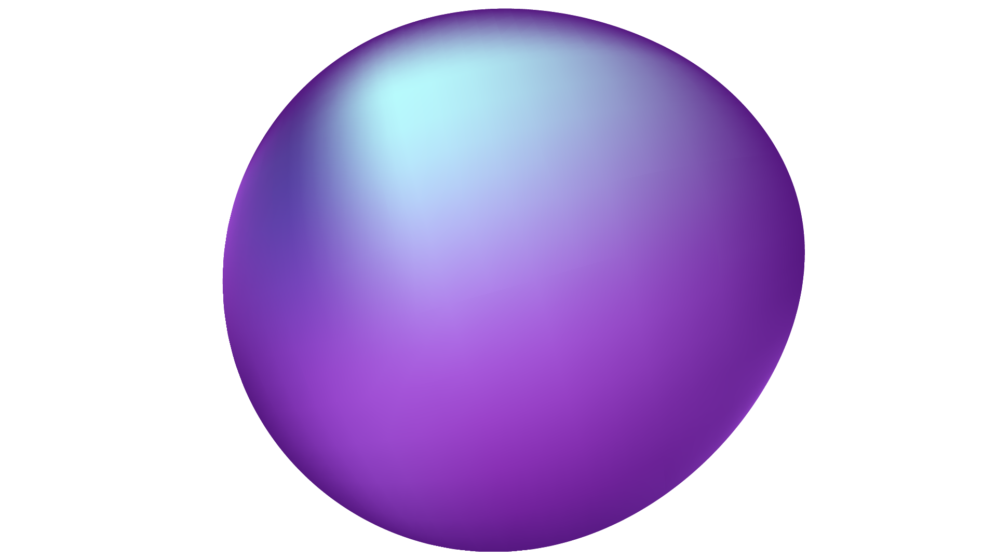
TikTok TechJam 2024
GenAI Story Teller (GAIST)
Problem Statement: Inspiring Creativity with Generative AI

Slide 2
TABLE OF CONTENTS
01
02
03
04
05
Problem Statement
Our Solution
How It Works
Examples
Web Demo

Slide 3
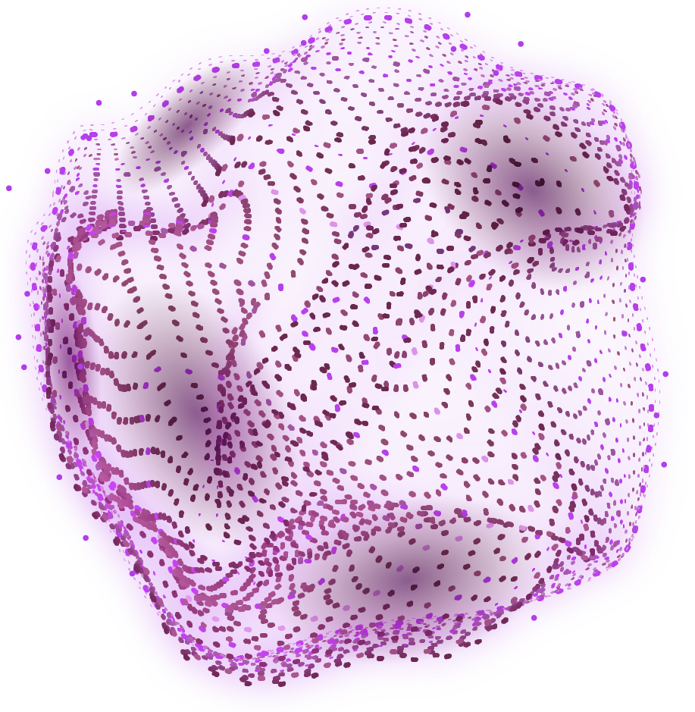
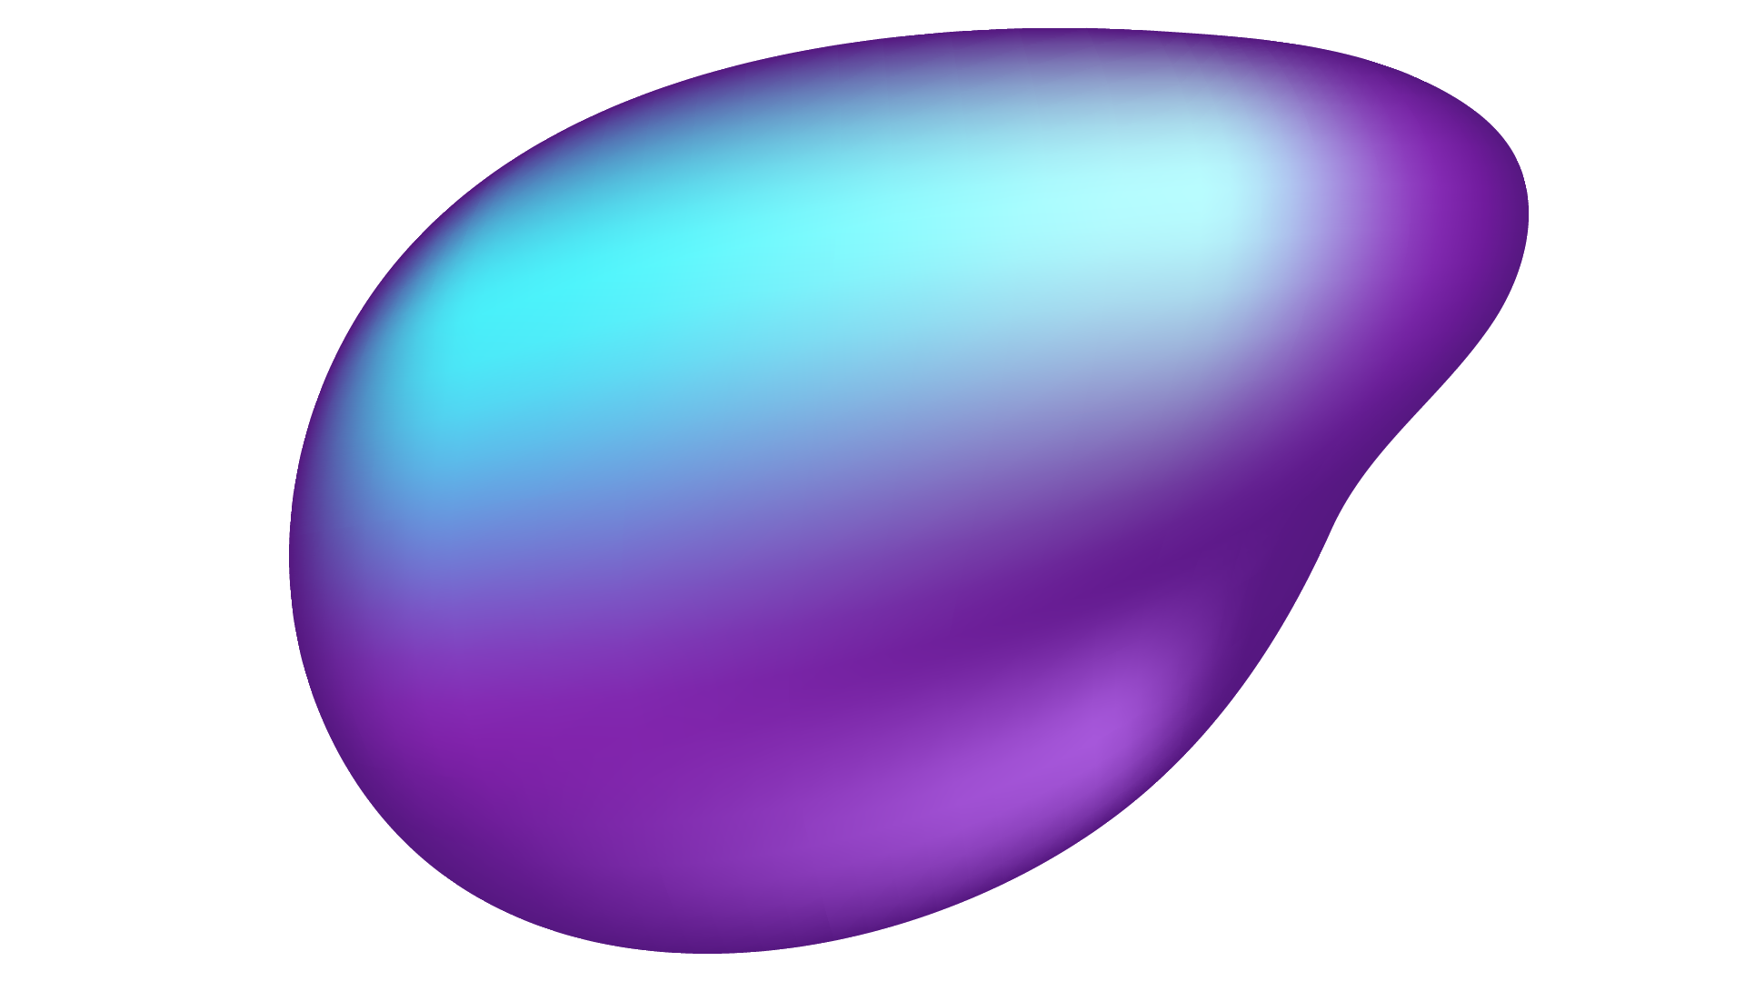
Problem Statement
Inspiring Creativity with Generative AI

Slide 4
Generative AI
Enhance
Transforming
Aid
media content by optimizing & extracting information
styles to meet diverse audience preferences
creators in producing higher quality content efficiently

Slide 5
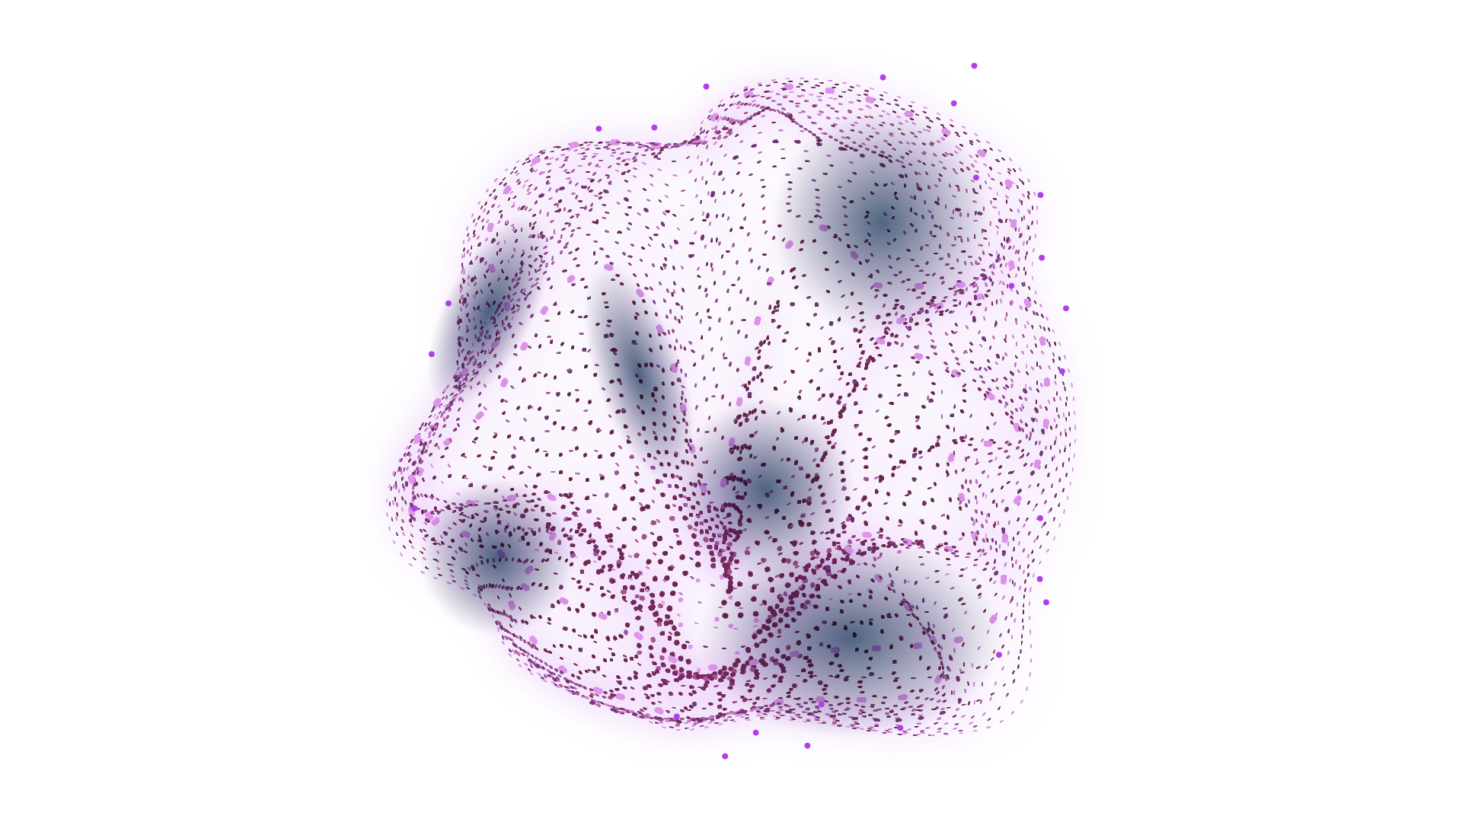
Our Solution
GenAI StoryTeller (GAIST)

Slide 6
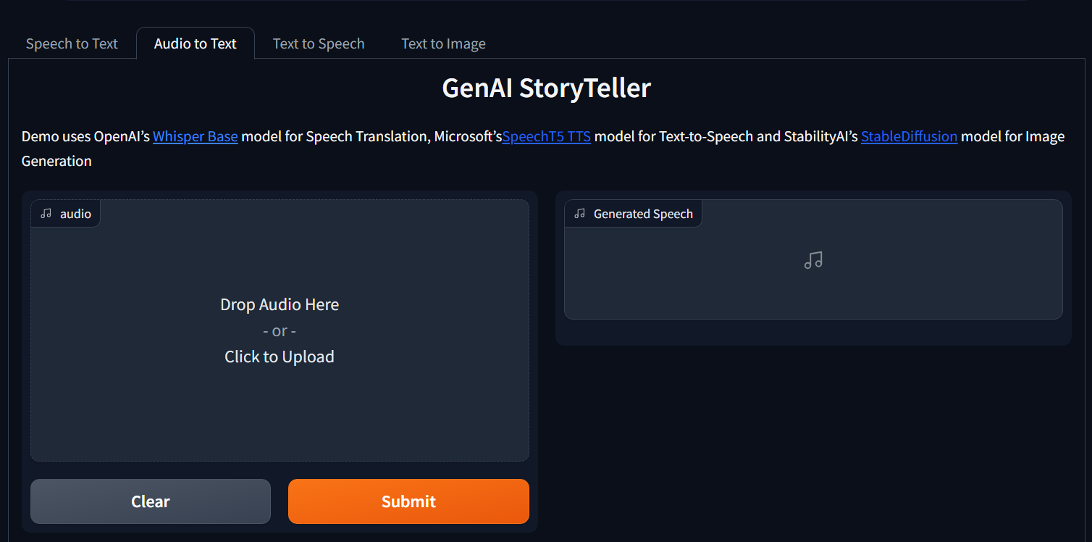

Slide 7

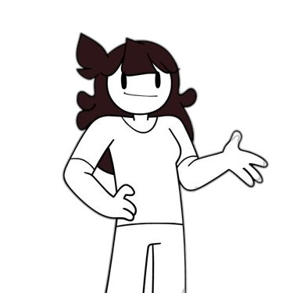
OUR INSPIRATIONS
Reddit Stories
Animators

Slide 8
How It Works
1
OpenAI’s Whisper Base model for Speech Translation
2
Microsoft’s SpeechT5 TTS model for Text-to-Speech
3
StabilityAI’s StableDiffusion model for Image Generation

Slide 9
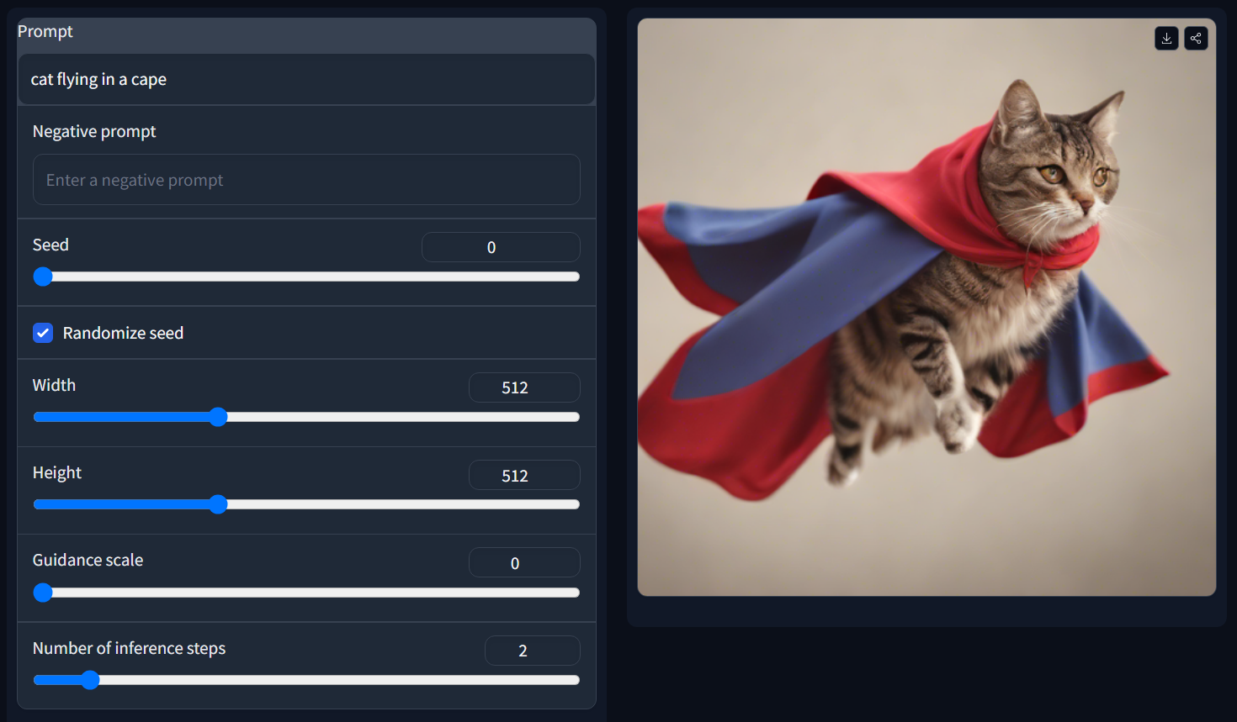
Examples

Slide 10
Web Demo
https://huggingface.co/spaces/thianfoo/GenAI_StoryTeller

Slide 11
Thank you for your time!

